Slide 1
UNIT 3 DISPLAY DEVICES,LIGHT SOURCES AND DETECTION DEVICES

Slide 2
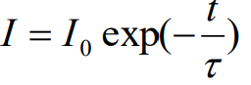
LUMINESCENCE
It is the process where a material absorbs energy and then immediately emits visible or near-visible radiation. It consists of electron excitation and then dropping down to lower energy states.
If the emission of radiation occurs within 10⁻⁸ sec.s after excitation, the luminescence is called fluorescence, and if it takes longer than 10⁻⁸ sec.s, it is known as phosphorescence.
Ordinarily pure materials do not display this phenomenon. Special materials called phosphors have the capability of absorbing high-energy radiation and spontaneously emitting lower-energy radiation. Ex.: some sulfides, oxides, tungstates, and few organic materials.
The intensity of luminescence is given as:

Slide 3
Luminescence
Luminescence
Luminescence is spontaneous emission of light by a substance not resulting from heat; or "cold light".
It is thus a form of cold-body radiation. It can be caused by chemical reactions, electrical energy, subatomic motions or stress on a crystal. This distinguishes luminescence from incandescence, which is light emitted by a substance as a result of heating.

Slide 4
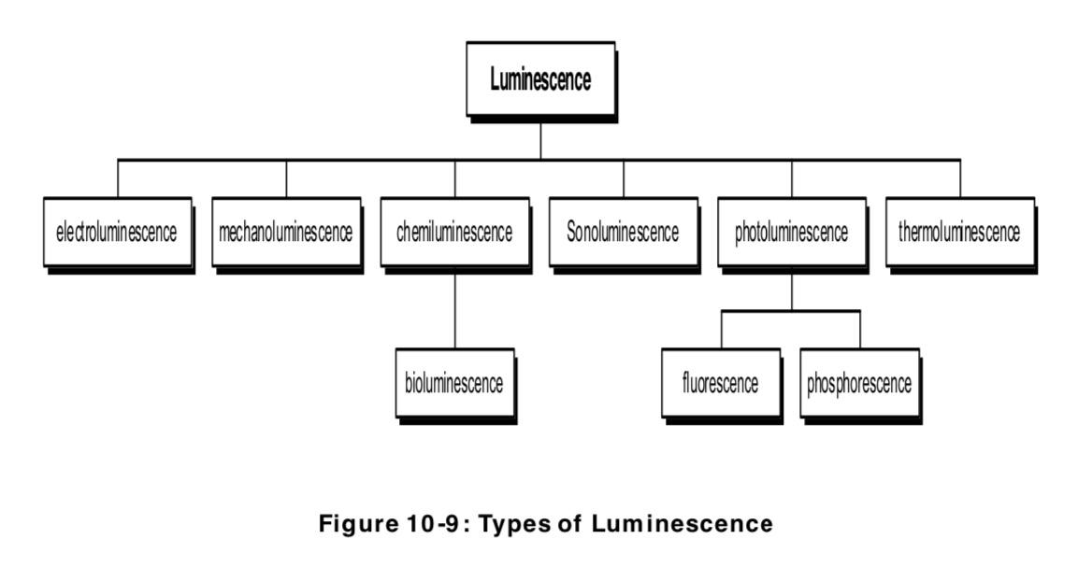

Slide 5
A material that emits light is called luminescent material
It emits energy from an excited electronic state as light.
Some of the incident energy is absorbed and re-emitted as light of a longer wavelength.
The wavelength of the emitted light is characteristic of the luminescent substance and not of the incident radiation.
The emitted light carries the materials signature.

Slide 6
PHOTOLUMINESCENCE
Based on source for electron excitation, luminescence is three types: photo-luminescence, cathode-luminescence, and electro-luminescence.
Photo-luminescence occurs in fluorescent lamps.
Here ultra-violet radiation from low-pressure mercury arc is converted to visible light by calcium halo-phosphate phosphor (Ca₁₀F₂P₆O₂₄).
In commercial lamps, about 20% of F - ions are replaced with Clions.
Antimony, Sb³⁺ , ions provide a blue emission while manganese, Mn²⁺ , ions provide an orange-red emission band.

Slide 7
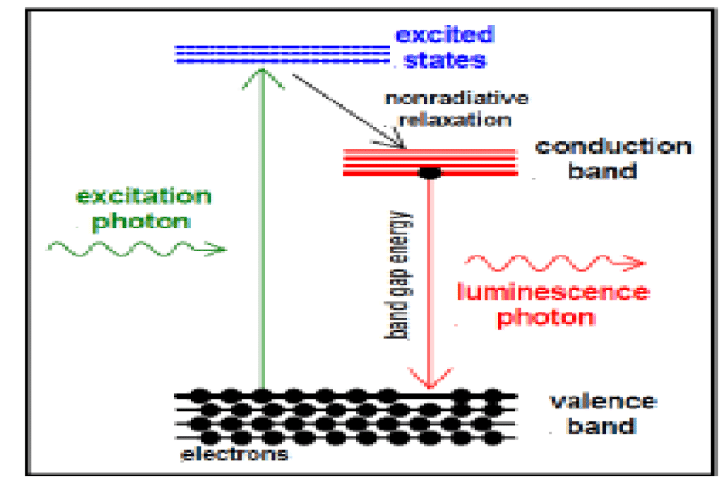

Slide 8
PHOTOLUMINESCENCE
Photoluminescence in semiconductors and dielectrics can usually only occur for illumination of a substance with light which has a photon energy above the band gap energy.
The photoluminescence usually occurs for wavelengths around the band gap wavelength.
In many cases, photoluminescence occurs only with certain dopants or impurities in a material.
For example, fluorescence can occur when rare-earth-doped laser gain media are pumped with light which can excite the rare earth ions. Here, the emission can occur in various wavelength bands corresponding to optical transitions of those ions.
One may obtain more than one photon per absorbed photon, when there is a cascade of transitions.
Photoluminescence may be largely suppressed (quenched) if there are fast non-radiative transitions to lower energy levels, leading to a very small lifetime of the excited levels..
Notes:
‹#›

Slide 9
Fluorescence is a short-lived photoluminescence, excited by irradiation of a substance with light.
The light hitting a sample puts atoms, ions or molecules in the sample into excited states (by absorption of photons), from where they decay into lower-lying states (e.g. their ground states) through spontaneous emission of fluorescence photons.
This phenomenon is exploited for illumination, particularly in fluorescent lamps.
It also occurs at a side effect in various kinds of optically pumped lasers and amplifiers, e.g. in solid-state doped-insulator lasers and amplifiers (including fiber lasers and fiber amplifiers), in optically pumped semiconductor lasers, and in dye lasers. The resulting radiation is called fluorescent light.

Slide 10
Phosphorescence is a kind of luminescence (i.e., a kind of light emission of a medium) which lasts relatively long after excitation of the medium with light (for example many milliseconds or more).
The excitation energy is stored in metastable electronic states(excited states (particularly electronic states in laser gain media) which have a relatively long lifetime due to slow radiative and non-radiative decay), exhibiting only forbidden transitions to lower states.
There are also cases with delayed fluorescence.
As the stored energy can be released only through relatively slow processes, phosphorescence is generally much weaker than fluorescence.
Important phosphorescent materials are europium-doped strontium aluminate (Eu²⁺:SrAl₂O₄) and zinc sulfide (Eu²⁺:ZnS).
They are used e.g. in safety products such as exit signs, which are visible even under conditions of power failure, although they are not very bright.

Slide 11
Photoluminescence is sometimes used for the characterization of photonic devices or parts thereof.
For example, one may irradiate a semiconductor wafer, on which additional layers for a semiconductor laser or a saturable absorber(light absorbers with a degree of absorption which is reduced at high optical intensities) have been fabricated, with short-wavelength light for exciting photoluminescence.
The optical spectrum(the decomposition of the power or energy of light according to different wavelengths or optical frequencies) of the photoluminescence (PL spectrum) and also the dependence of its intensity on the irradiation intensity and device temperature can deliver important information for device characterization.
In particular, PL spectra and their intensity dependencies can allow one
to determine the band gap energy
to estimate the wavelength of maximum gain
to determine the composition of ternary or quaternary layers
to determine impurity levels to investigate recombination mechanisms

Slide 12
Cathode-luminescence
Cathode-luminescence is produced by an energized cathode which generates a beam of high-energy bombarding electrons. Ex.: Applications of this include electron microscope; cathode-ray oscilloscope; color television screens.
The modern televisions have very narrow, about 0.25 mm wide, vertical stripes of red-, green-, and blue- emitting phosphors deposited on the inner surface of the screens.
Commercial phosphors for different colors are: red – yttrium oxy-sulfide (Y₂O₂S) with 3% europium (Eu); green – (Zn,Cd)S with a Cu⁺ acceptor and Al³⁺ donor; blue – zinc sulfide (ZnS) with Ag⁺ acceptor and Cl⁻ donor.

Slide 13
Cathodoluminescence
Cathodoluminescence is an optical and electromagnetic phenomenon in which electrons impacting on a luminescent material such as a phosphor, cause the emission of photons which may have wavelengths in the visible spectrum.
A familiar example is the generation of light by an electron beam scanning the phosphor-coated inner surface of the screen of a television that uses a cathode ray tube.
Cathodoluminescence is the inverse of the photoelectric effect, in which electron emission is induced by irradiation with photons.

Slide 14
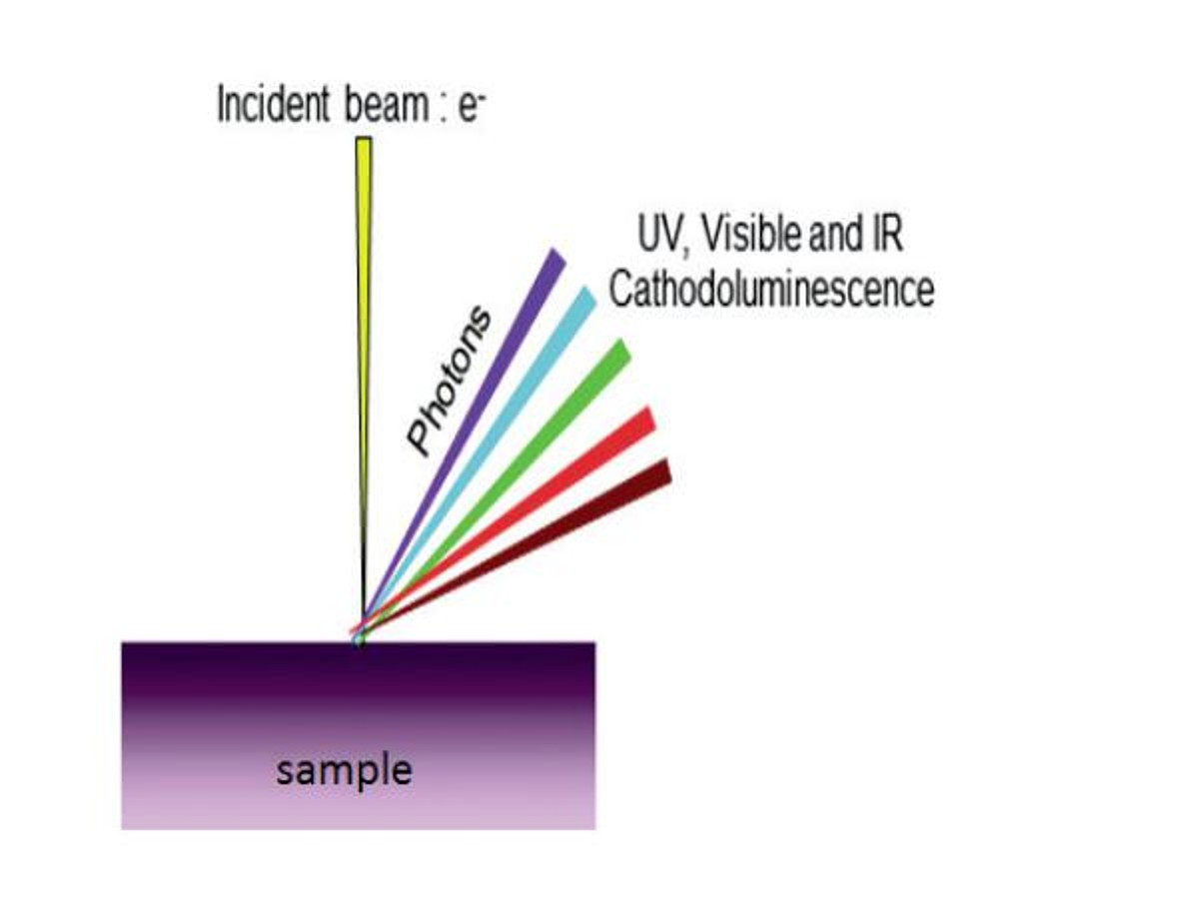

Slide 15
Luminescence in a semiconductor results when an electron in the conduction band recombines with a hole in the valence band. The difference energy (band gap) of this transition can be emitted in form of a photon.
The energy (color) of the photon, and the probability that a photon and not a phonon will be emitted, depends on the material, its purity, and the presence of defects.
First, the electron has to be excited from the valence band into the conduction band. In cathodoluminescence, this occurs as the result of an impinging high energy electron beam onto a semiconductor.
However, these primary electrons carry far too much energy to directly excite electrons. Instead, the inelastic scattering of the primary electrons in the crystal leads to the emission of secondary electrons, Auger electrons and X-rays, which in turn can scatter as well. Such a cascade of scattering events leads to up to 10³ secondary electrons per incident electron.
These secondary electrons can excite valence electrons into the conduction band when they have a kinetic energy about three times the band gap energy of the material.s
From there the electron recombines with a hole in the valence band and creates a photon. The excess energy is transferred to phonons and thus heats the lattice.

Slide 16
Cathodoluminescence Applications
Cathodoluminescence emission can be used to explore many fundamental properties of matter.
It can be used to study light transport, scattering, electronic structure of materials, including semiconductors, (e.g. bandgap, defects), resonant phenomena.
Cathodoluminescence imaging is also an ideal tool to study geological samples. The CL emission from a rock gives insights into crystal growth, zonation, cementation, replacement, deformation, provenance, trace elements, and defect structures

Slide 17
INJECTION LUMINESCENCE
If a p-n junction diode is forward biased, the majority carriers from both sides cross the junction and enter the opposite sides.
This results in an increase in the minority carrier concentration on the two sides.
The excess minority carrier concentration, of course, depends on the impurity levels on the two sides.
This process is known as minority carrier injection.
The injected carriers diffuse away from the junction, recombining with majority carriers as they do so.
This recombination process of electrons with holes may be either nonradiative, in which the energy difference of the two carriers is released into the lattice as thermal energy, or radiative, in which a photon of energy equal to or less than the energy difference of the carriers is radiated.
The phenomenon of emission of radiation by the recombination of injected carriers is called injection luminescence. A p-n junction diode exhibiting this phenomenon is referred to as a light-emitting diode.

Slide 18
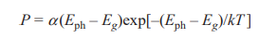
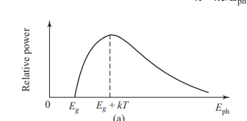
The spectral distribution of the radiated power P as a function of Eph is given by the following expression:
where α is a constant. The theoretical plot of relative power versus E_{ph} is shown in Fig

Slide 19
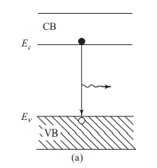
Radiation may be emitted via
i)The recombination of an electron in the CB with a hole in the VB .

Slide 20
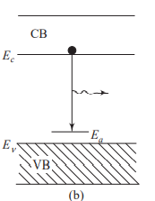
ii)The downward transition of an electron in the CB to an empty acceptor level, shown in Fig.

Slide 21
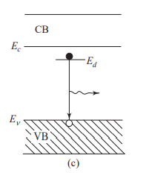
iii) The transition of an electron from a filled donor level to a hole in the VB, shown in Fig.

Slide 22
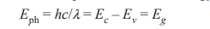
Spectrum of Injection Luminescence
If the transition takes place from the electron level at the bottom of the CB to the hole level at the top of the VB, the emitted photon will have energy
where h is Planck’s constant, c is the speed of light, and l is the wavelength of emitted radiation.
However, there is a distribution of electron energy levels in the CB and that of holes in the VB.
Thus, depending on the energy levels involved, there will be a range of photon energies that are emitted by the LED

Slide 23
Electro-luminescence
Electro-luminescence occurs in devices with p-n rectifying junctions which are stimulated by an externally applied voltage.
When a forward biased voltage is applied across the device, electrons and holes recombine at the junction and emit photons in the visible range (mono-chromatic light i.e. singe color). These diodes are called light emitting diodes (LEDs).
LEDs emit light of many colors, from red to violet, depending on the composition of the semiconductor material used. Ex.: GaAs, GaP, GaAlAs, and GaAsP are typical materials for LEDs.

Slide 24
Electro luminescence
Electroluminescence (EL) is an optical phenomenon and electrical phenomenon in which a material emits light in response to the passage of an electric current or to a strong electric field.
Electroluminescence is the result of radiative recombination of electrons & holes in a material, usually a semiconductor.
The excited electrons release their energy as photons - light. Prior to recombination, electrons and holes may be separated either by doping the material to form a p-n junction (in semiconductor electroluminescent devices such as light-emitting diodes) or through excitation by impact of high-energy electrons accelerated by a strong electric field (as with the phosphors in electroluminescent displays).

Slide 25
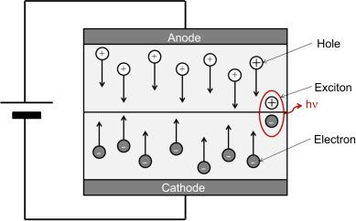

Slide 26
Electroluminescent devices are fabricated using either organic or inorganic electroluminescent materials. The active materials are generally semiconductors of wide enough bandwidth to allow the exit of the light.
The most typical inorganic thin-film EL (TFEL) is ZnS:Mn with yellow-orange emission. Examples of the range of EL material include:
Powdered zinc sulfide doped with copper (producing greenish light) or silver (producing bright blue light)
Thin-film zinc sulfide doped with manganese (producing orange-red color)
Naturally blue diamond, which includes a trace of boron that acts as a dopant.
Semiconductors containing Group III and Group V elements, such as indium phosphide (InP), gallium arsenide (GaAs), and gallium nitride (GaN) (Light-emitting diodes)

Slide 27
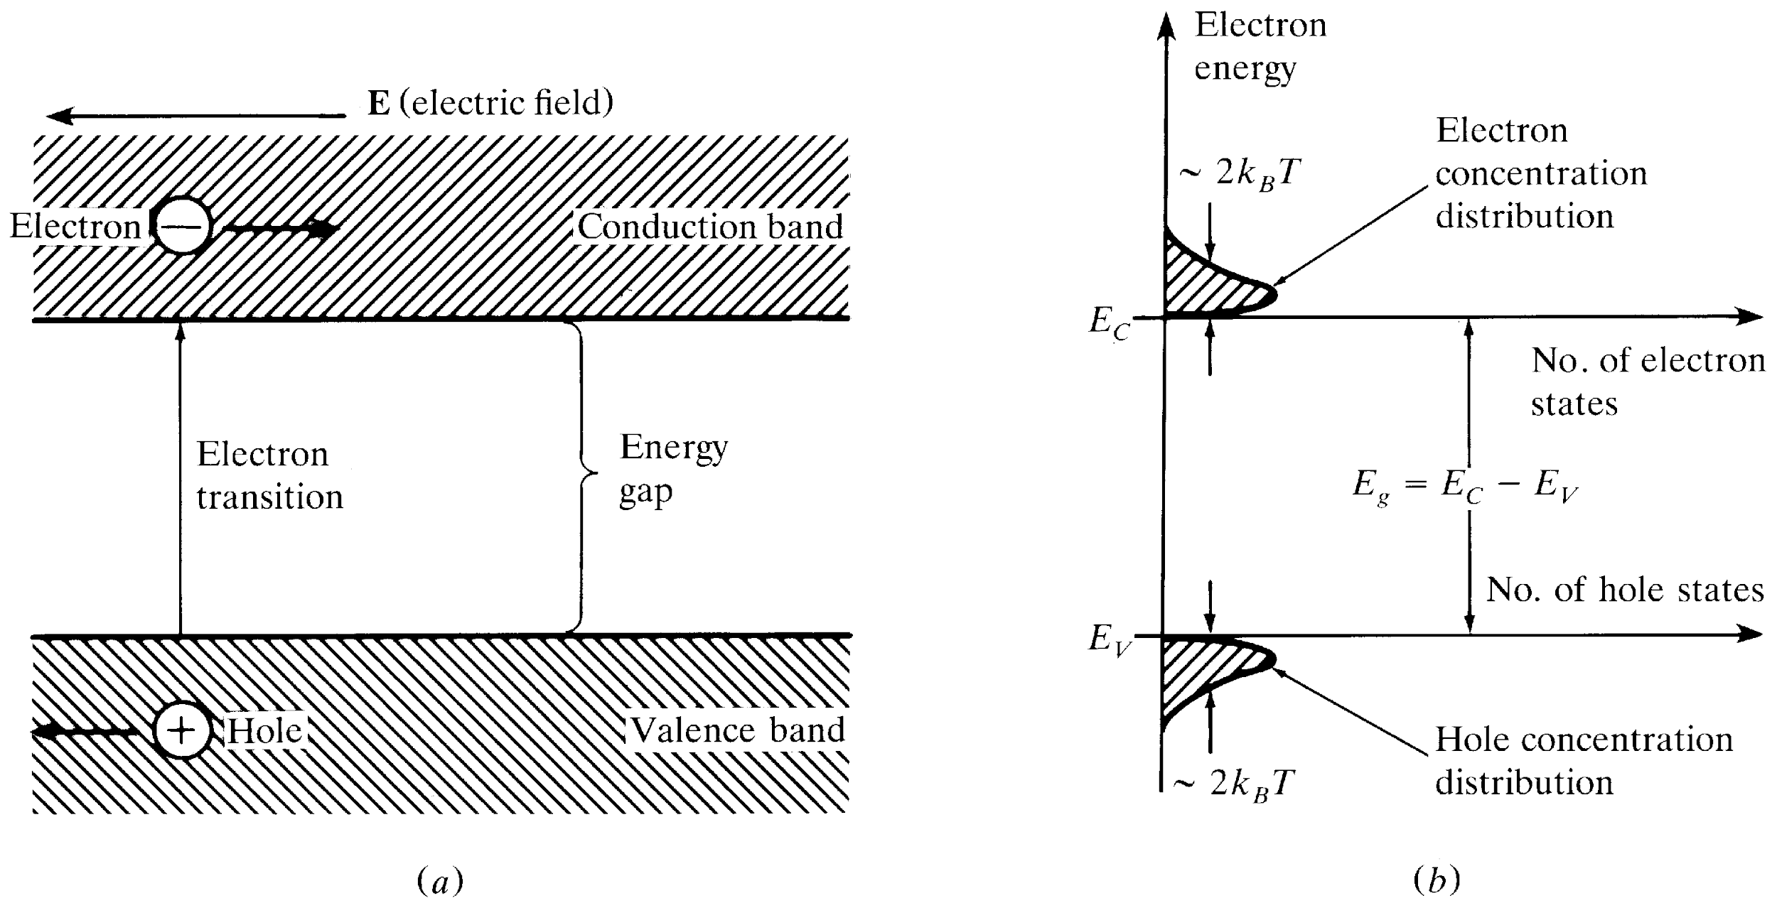
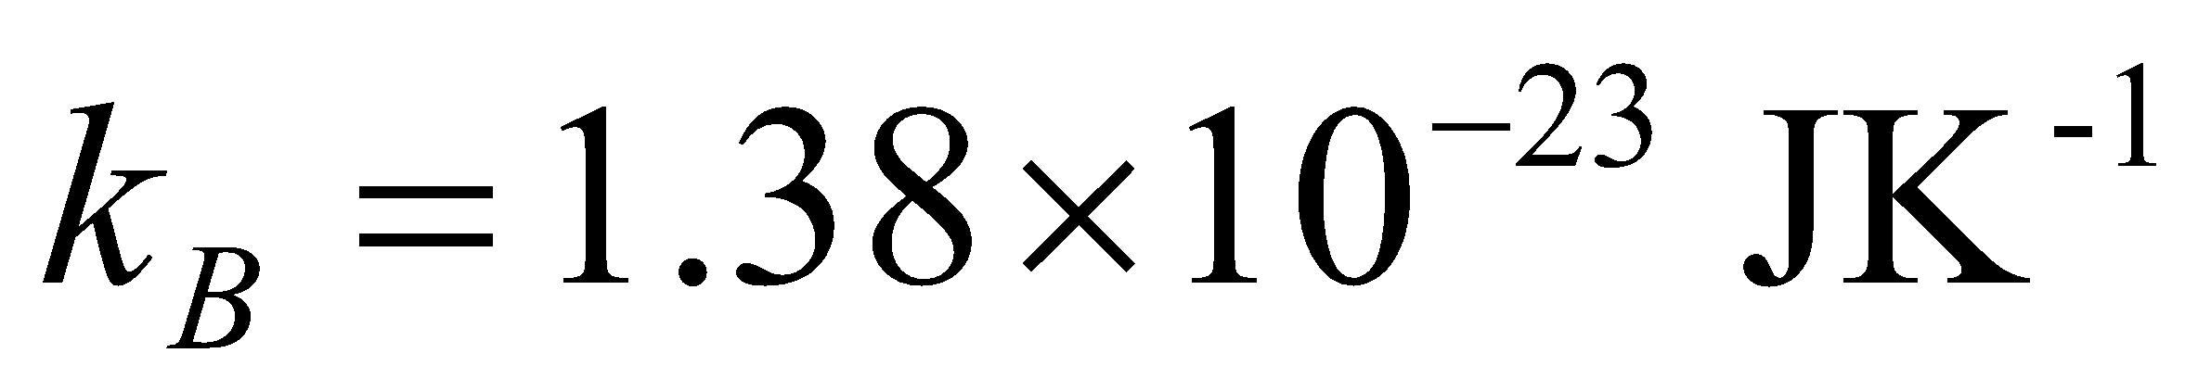
Review of Semiconductor Physics
a) Energy level diagrams showing the excitation of an electron from the valence band to the conduction band.
The resultant free electron can freely move under the application of electric field.
b) Equal electron & hole concentrations in an intrinsic semiconductor created by the thermal excitation of
electrons across the band gap
Optical Fiber communications, 3rd ed.,G.Keiser,McGrawHill, 2000

Slide 28
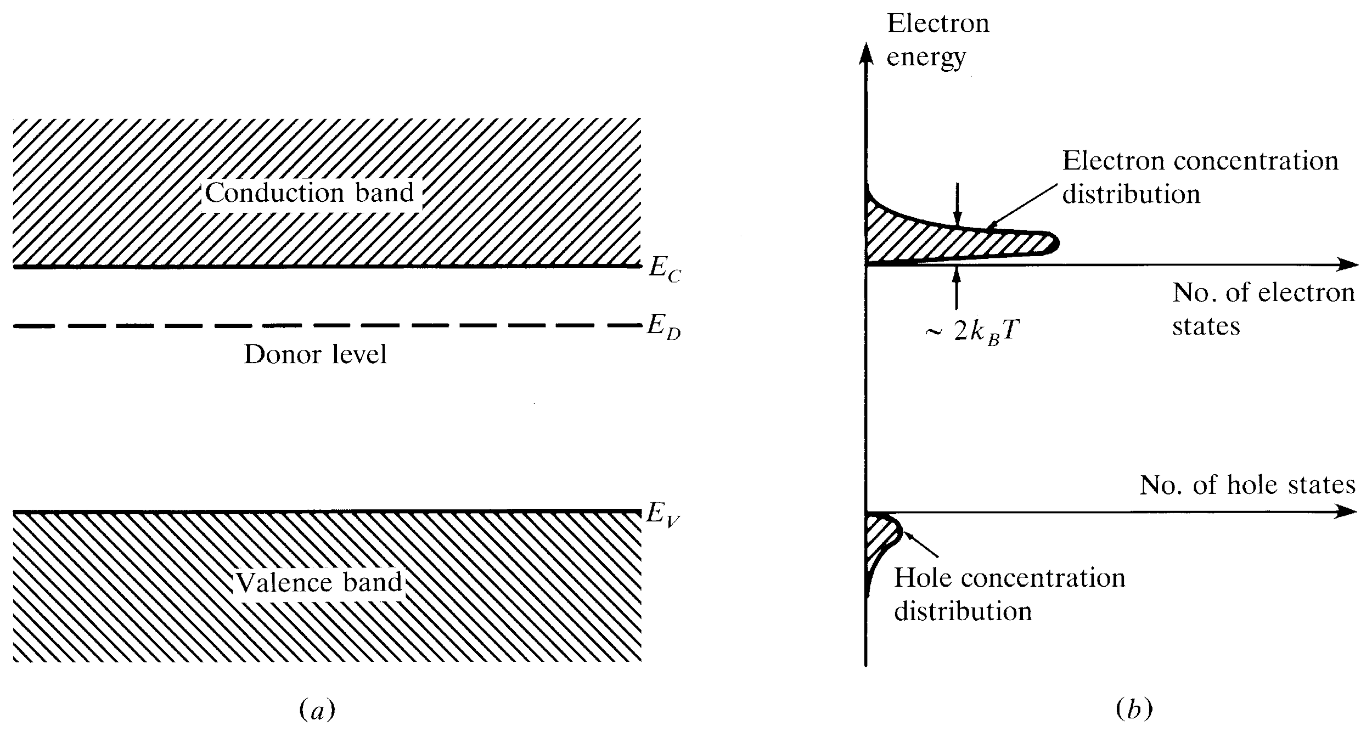
n-Type Semiconductor
Donor level in an n-type semiconductor.
The ionization of donor impurities creates an increased electron concentration distribution.
Optical Fiber communications, 3rd ed.,G.Keiser,McGrawHill, 2000

Slide 29
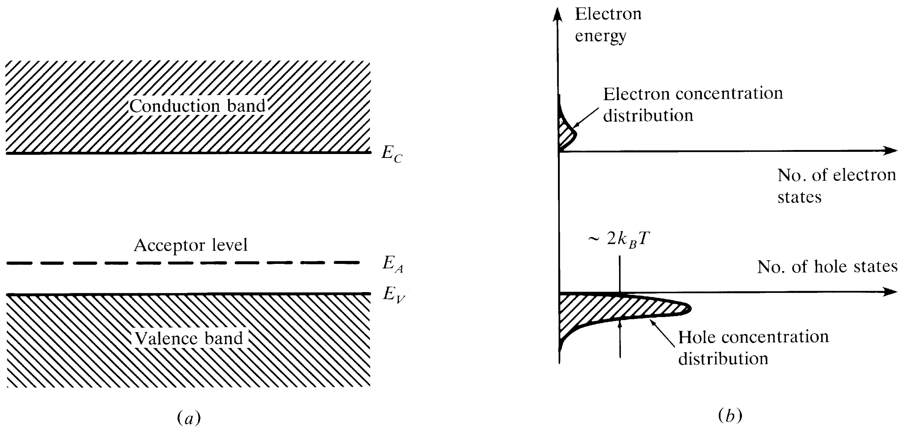
p-Type Semiconductor
Acceptor level in an p-type semiconductor.
The ionization of acceptor impurities creates an increased hole concentration distribution
Optical Fiber communications, 3rd ed.,G.Keiser,McGrawHill, 2000

Slide 30
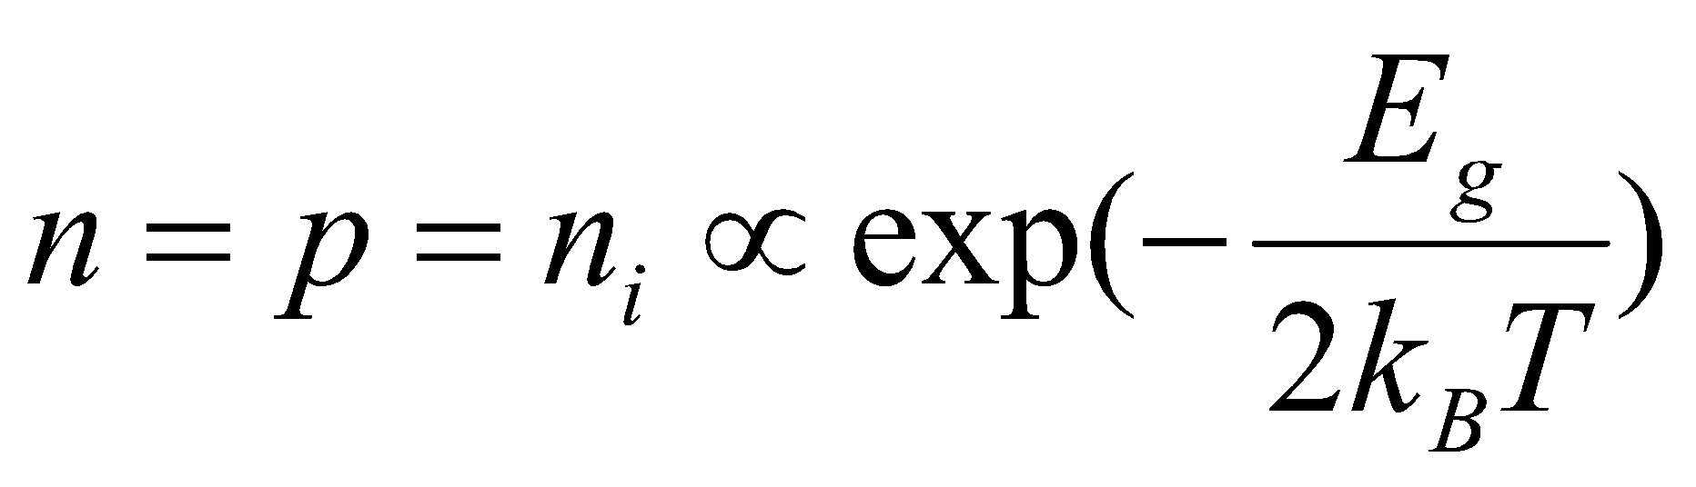
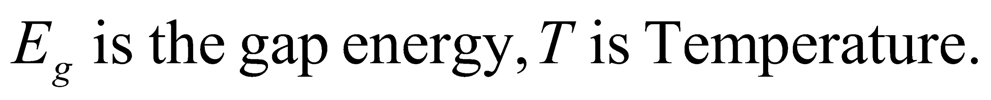
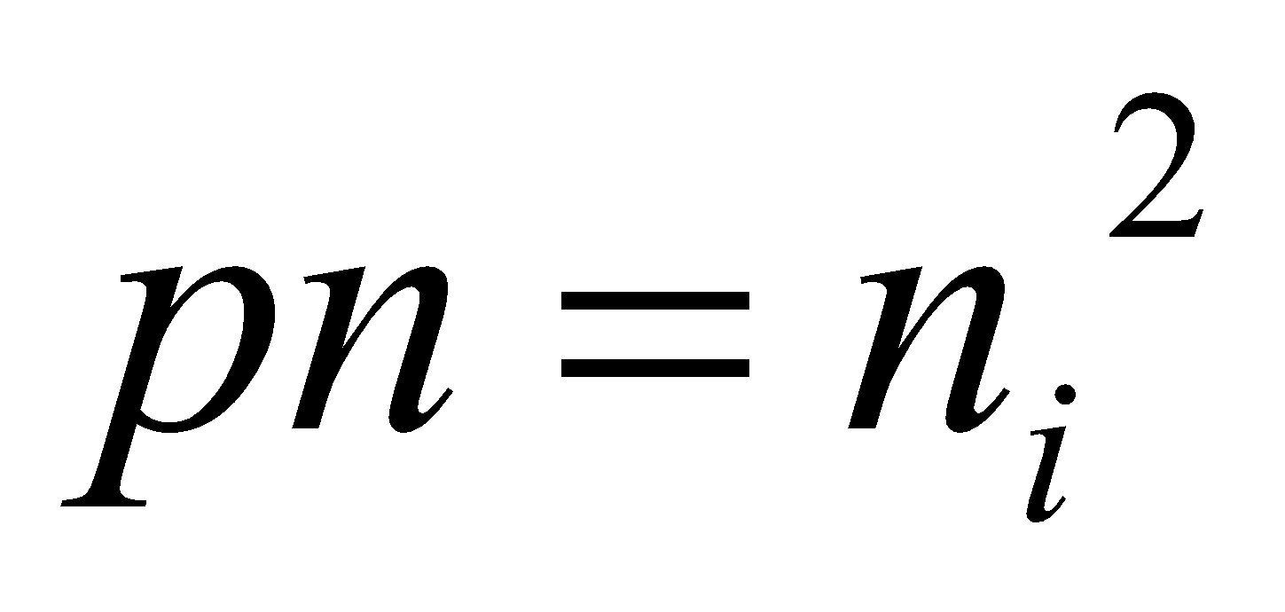
Intrinsic & Extrinsic Materials
Intrinsic material: A perfect material with no impurities.
Extrinsic material: donor or acceptor type semiconductors.
Majority carriers: electrons in n-type or holes in p-type.
Minority carriers: holes in n-type or electrons in p-type.
The operation of semiconductor devices is essentially based on the injection and extraction of minority carriers.
[4-1]
[4-2]

Slide 31
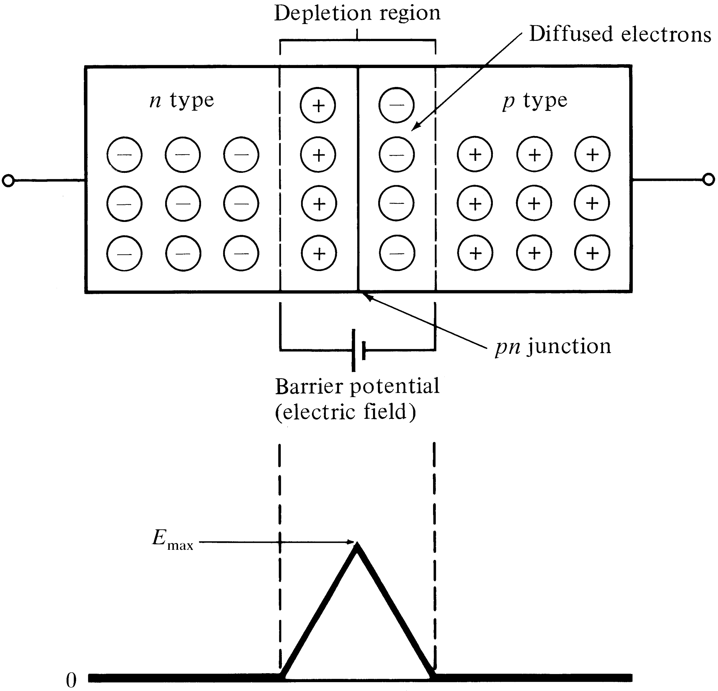
The pn Junction
Electron diffusion across a pn junction
creates a barrier potential (electric field)
in the depletion region.
Optical Fiber communications, 3rd ed.,G.Keiser,McGrawHill, 2000

Slide 32
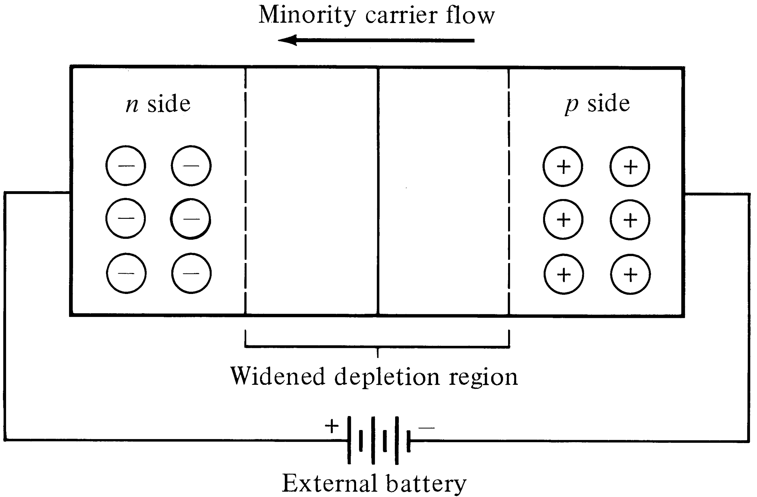
Reverse-biased pn Junction
A reverse bias widens the depletion region, but allows minority carriers to move freely with the applied field.
Optical Fiber communications, 3rd ed.,G.Keiser,McGrawHill, 2000

Slide 33
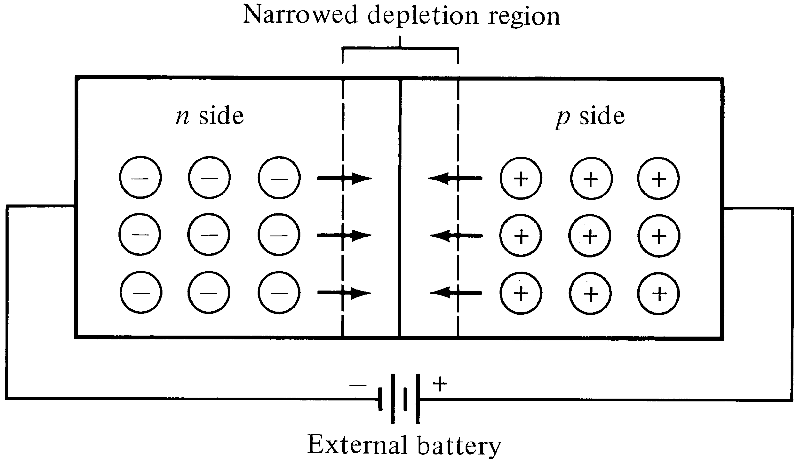
Forward-biased pn Junction
Lowering the barrier potential with a forward bias allows majority carriers to diffuse across the junction.
Optical Fiber communications, 3rd ed.,G.Keiser,McGrawHill, 2000

Slide 34
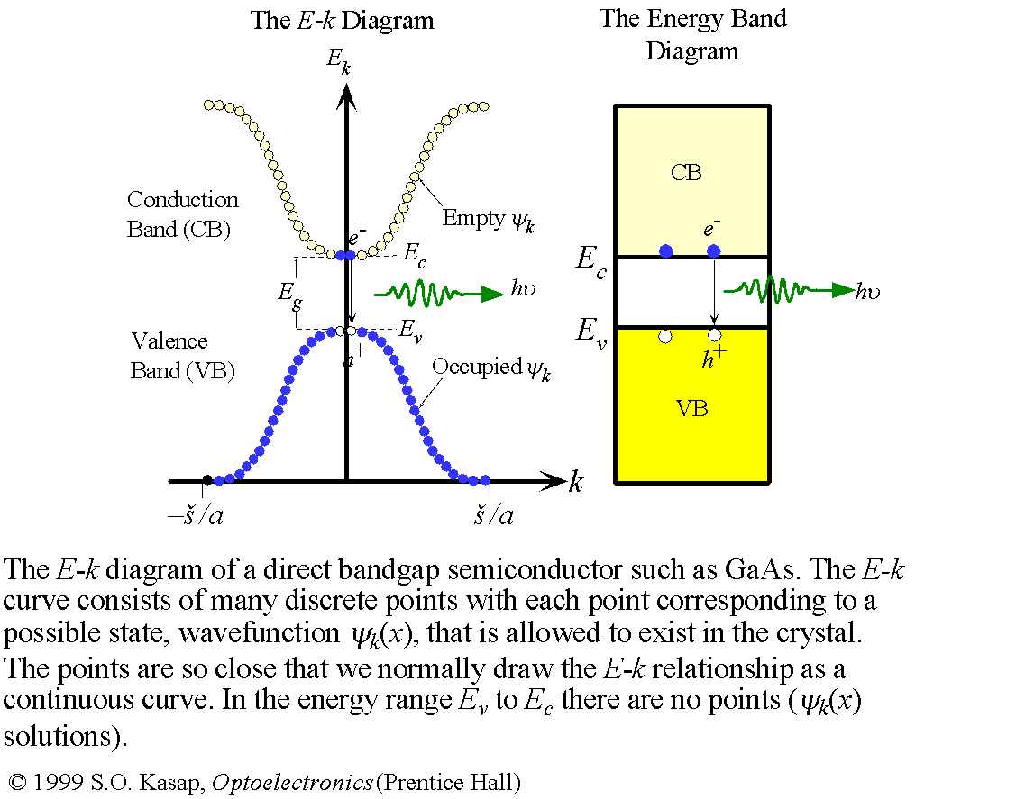
Direct Band Gap Semiconductors

Slide 35
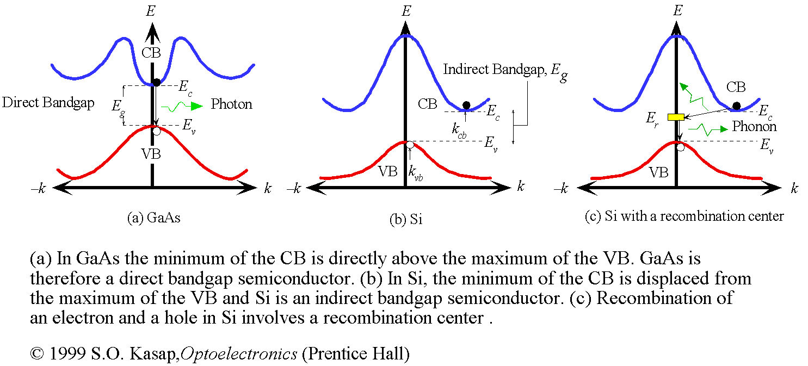
Indirect Band Gap Semiconductors

Slide 36
Light-Emitting Diodes (LEDs)
For photonic communications requiring data rate 100-200 Mb/s with multimode fiber with tens of microwatts, LEDs are usually the best choice.
LED configurations being used in photonic communications:
1- Surface Emitters (Front Emitters)
2- Edge Emitters

Slide 37
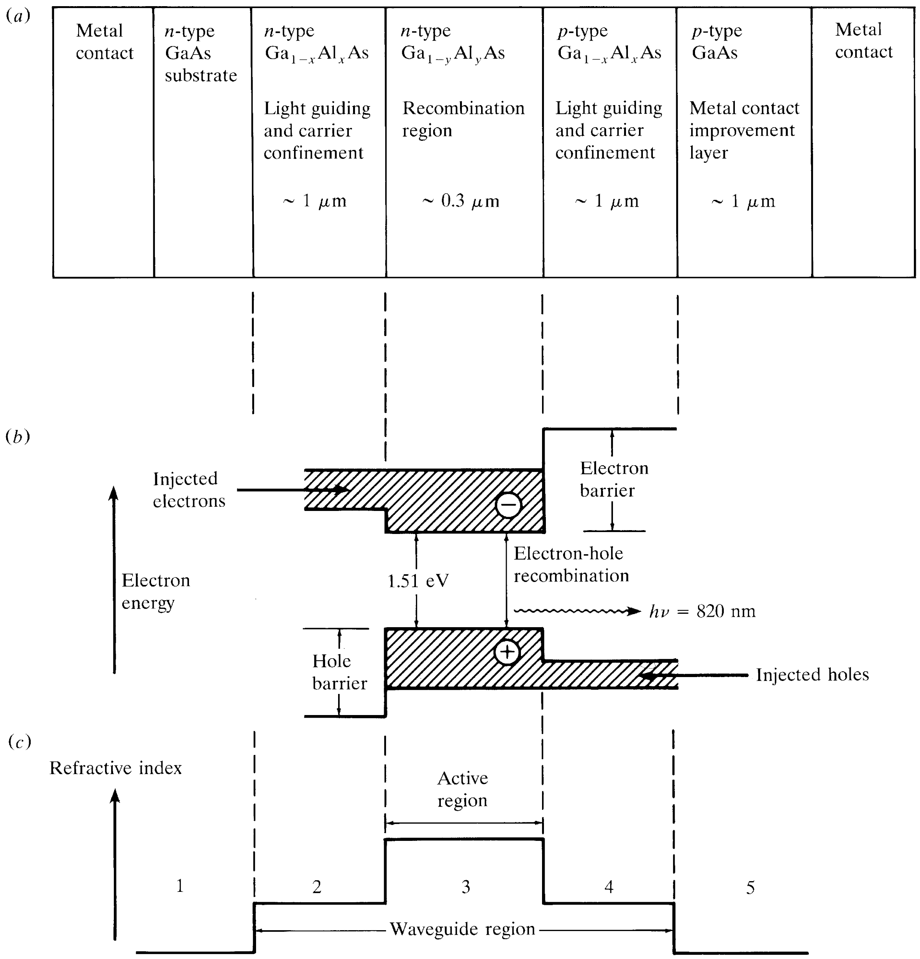
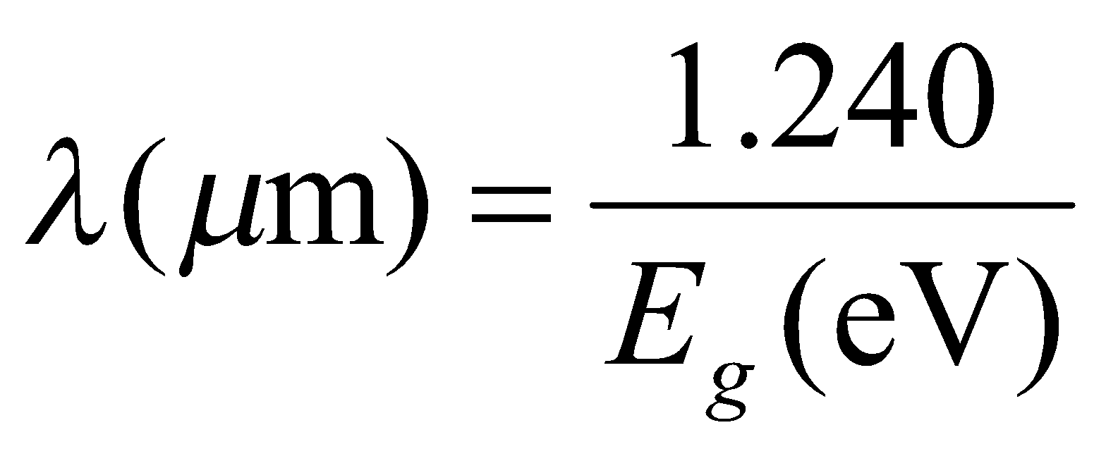
Cross-section drawing of a typical
GaAlAs double heterostructure light
emitter. In this structure, x>y to provide
for both carrier confinement and optical
guiding.
b) Energy-band diagram showing the
active region, the electron & hole
barriers which confine the charge carriers
to the active layer.
c) Variations in the refractive index; the
lower refractive index of the material in
regions 1 and 5 creates an optical barrier
around the waveguide because of the higher
band-gap energy of this material.
[4-3]
Optical Fiber communications, 3rd ed.,G.Keiser,McGrawHill, 2000

Slide 38
Light-Emitting Diodes (LEDs)
For optical communication systems requiring bit rates less than approximately 100–200 Mb/s together with multimode fiber-coupled optical power in the tens of microwatts, semiconductor light-emitting diodes (LEDs) are usually the best light source choice.
These LEDs require
Less complex drive circuitry than laser diodes
No thermal or optical stabilization circuits are needed
They can be fabricated less expensively with higher yields.

Slide 39
LED Structures
To be useful in fiber transmission applications, an LED must have a high radiance output, a fast emission response time, and a high quantum efficiency.
Its radiance (or brightness) is a measure, in watts, of the optical power radiated into a unit solid angle per unit area of the emitting surface.
High radiances are necessary to couple sufficiently high optical power levels into a fiber.
The emission response time is the time delay between the application of a current pulse and the onset of optical emission.
This time delay is the factor limiting the bandwidth with which the source can be modulated directly by varying the injected current.
The quantum efficiency is related to the fraction of injected electron–hole pairs that recombine radiatively.

Slide 40
To achieve a high radiance and a high quantum efficiency, the LED structure must provide a means of confining the charge carriers and the stimulated optical emission to the active region of the pn junction where radiative recombination takes place.
Carrier confinement is used to achieve a high level of radiative recombination in the active region of the device, which yields a high quantum efficiency.
Optical confinement is of importance for preventing absorption of the emitted radiation by the material surrounding the pn junction.

Slide 41
LED DESIGNS
Two basic structures of LED are in use. These are (i) surface-emitting LED (SLED) and (ii) edge-emitting LED (ELED).
Configurations based on GaAs/ GaAlAs have been used in short-haul applications, whereas those based on InGaAsP/ InP have been employed in medium-range fiber links.
Relatively recently, a third device known as a super luminescent diode (SLD) has also been increasingly used in communications.

Slide 42
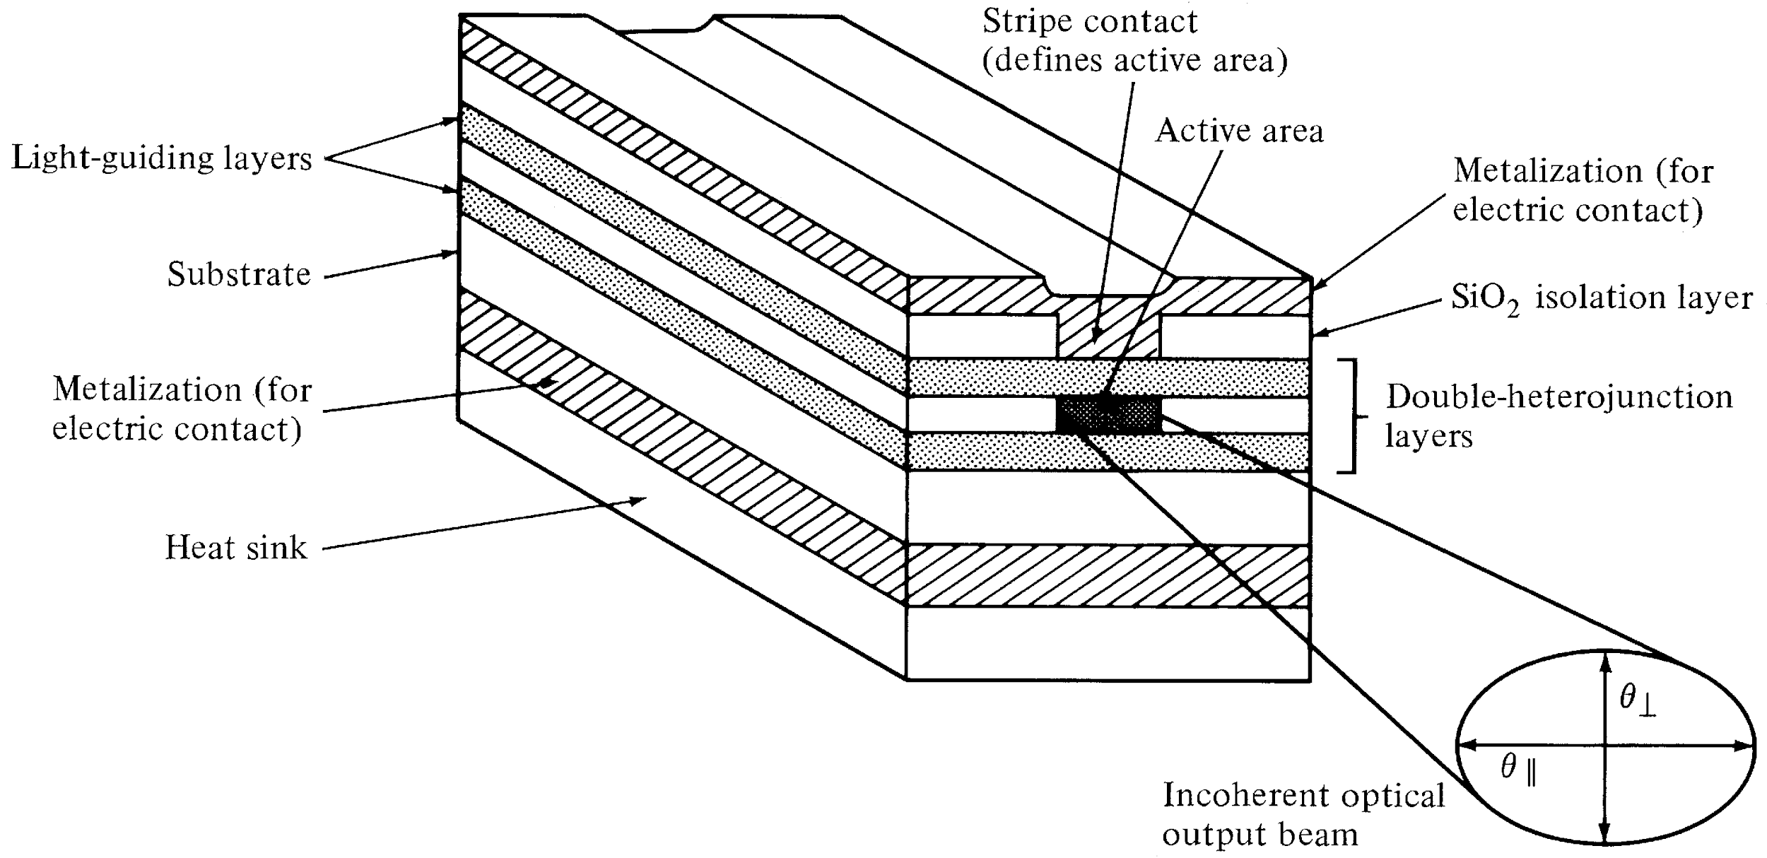
Edge-Emitting LED
Schematic of an edge-emitting double heterojunction LED. The output beam is
lambertian in the plane of junction and highly directional perpendicular to pn junction.
They have high quantum efficiency & fast response.
Optical Fiber communications, 3rd ed.,G.Keiser,McGrawHill, 2000

Slide 43
It is widely used in optical fiber communication system.
Here collimated light from LED is required to be fed into the fiber
with high coupling efficiency.
The figure depicts multilayer structure of InP based edge emitting LED.
It is used for long wavelength optical communication approx. between 1.33 to 1.55 µm.
Modern epitaxial growth techniques such as Molecular Beam Epitaxy (MBE), Metal-Organic Chemical Vapor Deposition (MOCVD) are used in order to design such complex LED structures.
The structure consists of five epitaxial layers.
Central active layer is made using InGaAs having narrow bandgap.
It is bounded by wide bandgap layers such as p+ InGaAsP and n+ InP cladding layers.
The positive contact is in the form of a stripe (the rest of the contact being isolated by the SiO2 layer).
These two cladding layers help in confining injected electrons and holes into the middle layer.
It also helps emitted photons to travel along LED axis as per optical properties.

Slide 44
Due to above, light is emitted from the edge of the LED. Hence it is known by the name edge emitting LED.
The rear-end facet is made reflecting while the front-end facet is coated with an antireflection coating, so that the laser action due to optical feedback is suppressed.
The self-absorption of radiation in the active layer is reduced because its thickness is made very small.
Much of the guided radiation propagates through the confining layers, which have a wider band gap. Therefore, they do not absorb this radiation.
The recombination radiation generated in the active region is guided by internal reflection at the heterojunctions and is brought out at the front-end facet of the diode.
An important effect of the optical guidance of emitted radiation is that the output beam has low divergence (typically ~30°) in the vertical direction.
This increases the efficiency of coupling the LED with the optical fiber.
Stripe geometry ELEDs based on InP/In GaAsP materials and with improved designs for coupling to single-mode fibers have also been made.
The optical power obtained from such a structure is 2 to 6 times smaller than that of a Surface emitting LED but more efficient coupling due to narrow band width.

Slide 45
Advantages of Edge Emitting LED
Following are the benefits or advantages of Edge Emitting LED: ➨It has superior beam collimation property which offers greater coupling efficiency with fiber optic cable compare to surface emitting LED. ➨It offers higher efficiency with low to high radiance. It fulfills high brightness LED requirements of the lighting industry. ➨It radiates less power to the air compare to surface emitting LED due to reabsorption and interfacial recombination. ➨It offers better modulation bandwidth and more directional emission pattern. ➨It offers 5-6 times more coupled power into NA (Numerical Aperture) of step/graded index fibers. This is due to small beam divergence. ➨It offers high data rates (> 20 Mbps) than surface emitting LED.

Slide 46
Disadvantages of Edge Emitting LED
Following are the drawbacks or disadvantages of Edge Emitting LED: ➨Its structure is complex. ➨It is difficult to design heat sink. ➨It is expensive compare to other LED types. ➨There are many issues to be handled during mechanical mounting and installation.

Slide 47
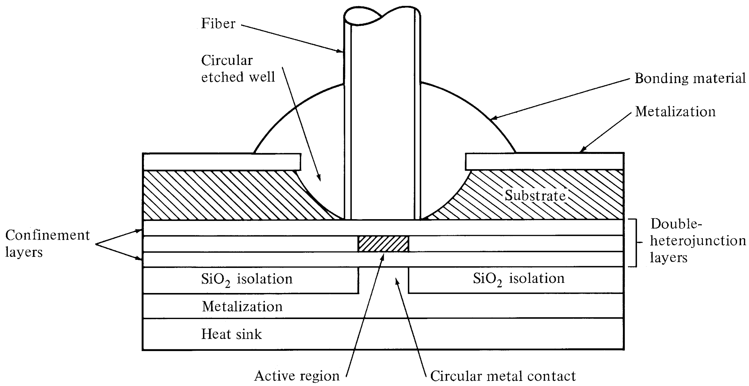
Surface-Emitting LED
Schematic of high-radiance surface-emitting LED. The active region is limitted
to a circular cross section that has an area compatible with the fiber-core end face.
Optical Fiber communications, 3rd ed.,G.Keiser,McGrawHill, 2000

Slide 48

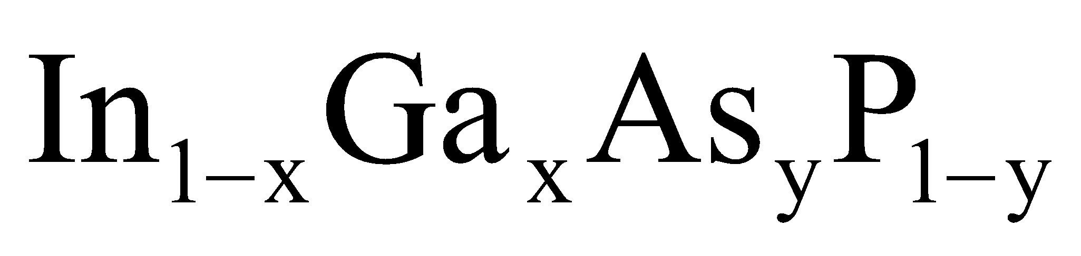
Light Source Material
Most of the light sources contain III-V ternary & quaternary compounds.
by varying x it is possible to control the band-gap energy and thereby the emission wavelength over the range of 800 nm to 900 nm. The spectral width is around 20 to 40 nm.
By changing 0<x<0.47; y is approximately 2.2x, the emission wavelength can be controlled over the range of 920 nm to 1600 nm. The spectral width varies from 70 nm to 180 nm when the wavelength changes from 1300 nm to 1600 nm. These materials are lattice matched.

Slide 49
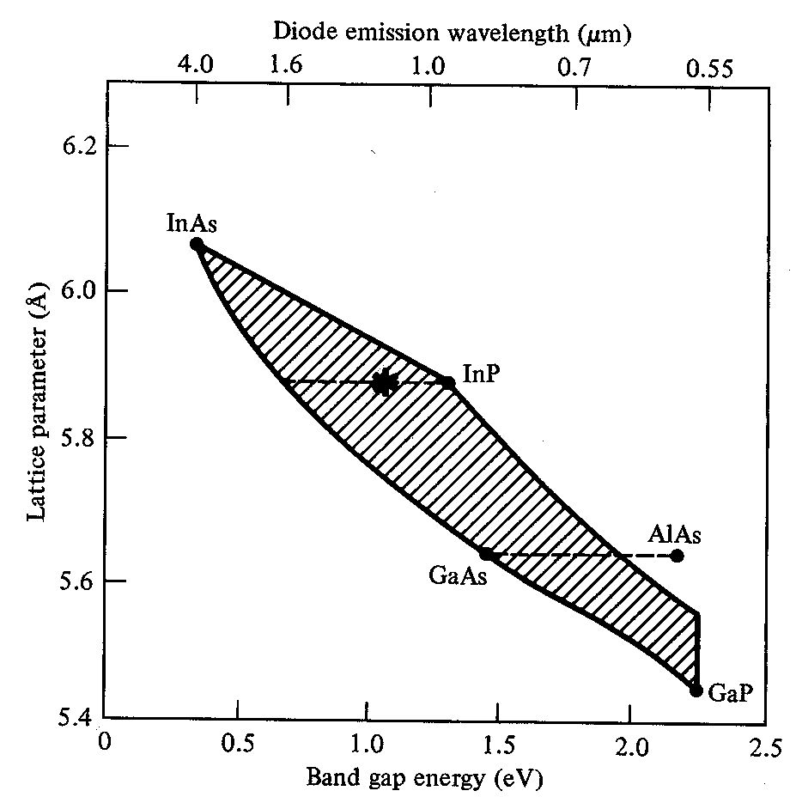
Optical Fiber communications, 3rd ed.,G.Keiser,McGrawHill, 2000

Slide 50
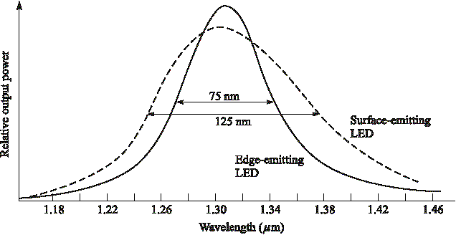
Spectral width of LED types
Optical Fiber communications, 3rd ed.,G.Keiser,McGrawHill, 2000

Slide 51
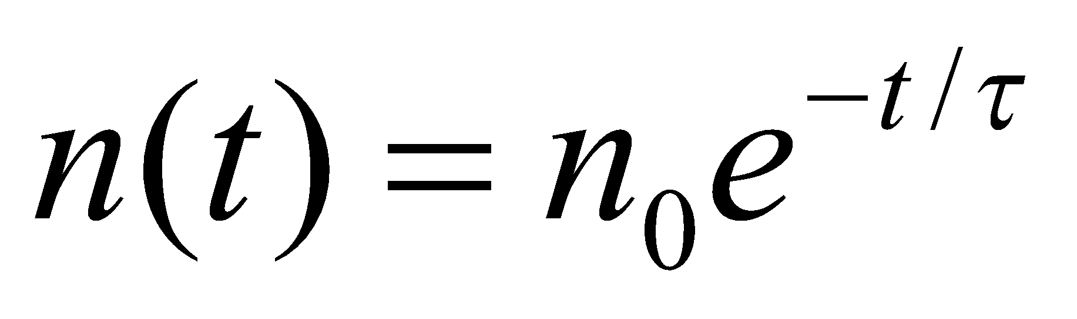
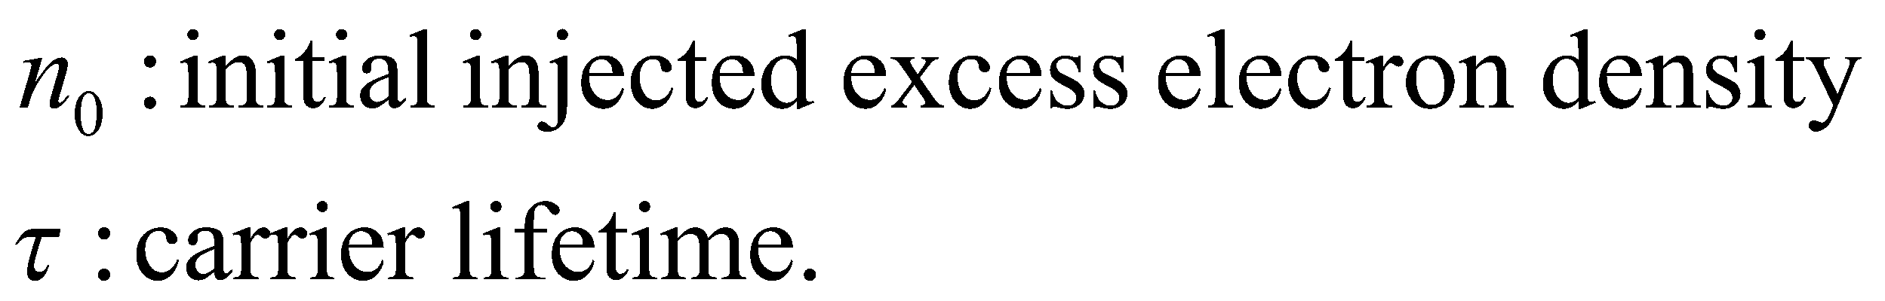
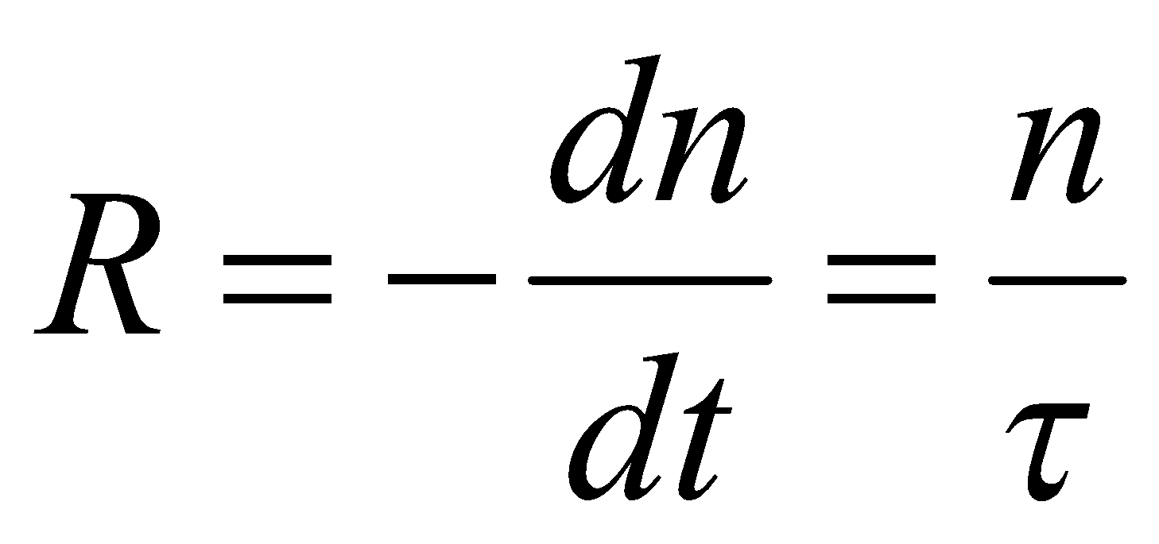
Rate equations, Quantum Efficiency & Power of LEDs
When there is no external carrier injection, the excess density decays exponentially due to electron-hole recombination.
n is the excess carrier density,
Bulk recombination rate R:
Bulk recombination rate (R)=Radiative recombination rate + nonradiative recombination rate
[4-4]
[4-5]

Slide 52
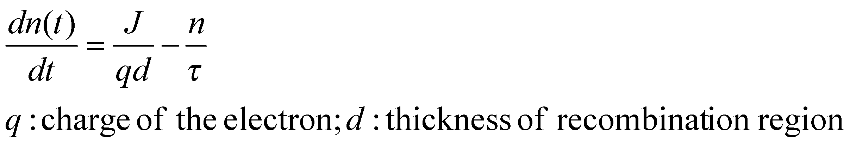
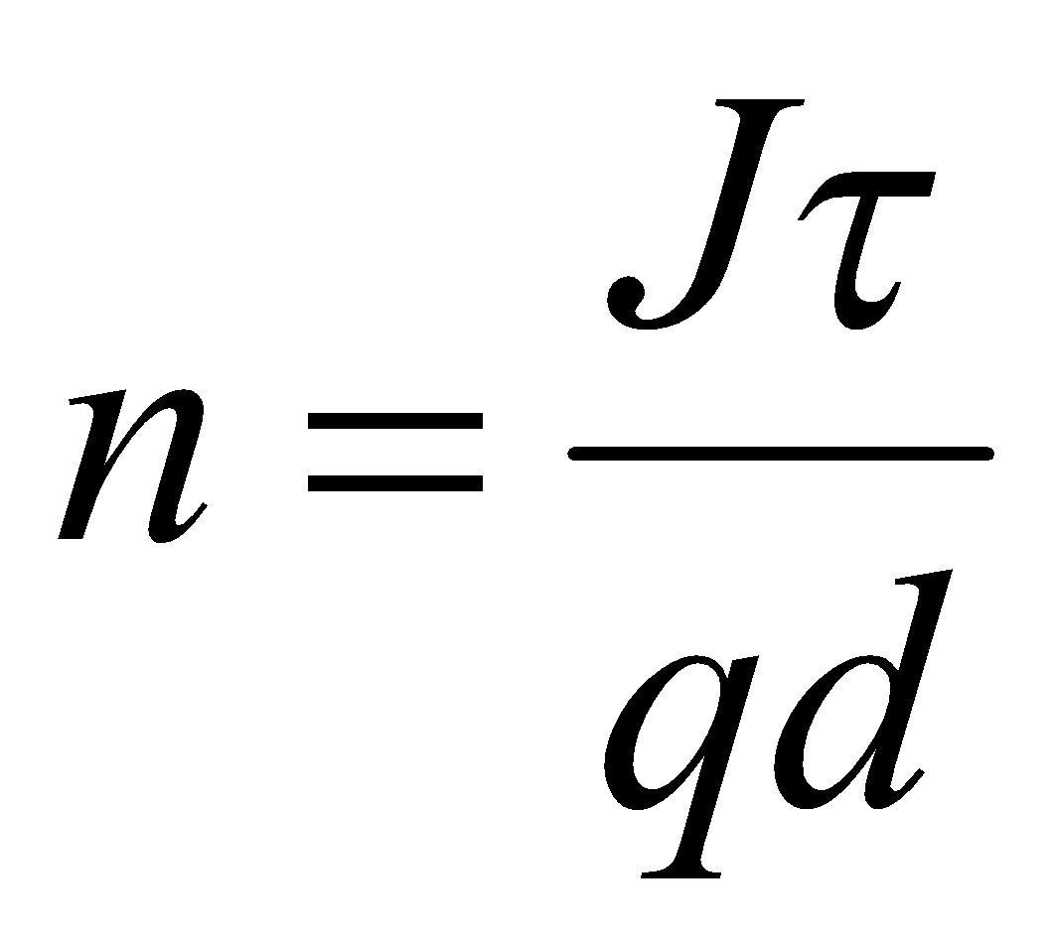
With an external supplied current density of J the rate equation for the electron-hole
recombination is:
[4-6]
In equilibrium condition: dn/dt=0
[4-7]

Slide 53
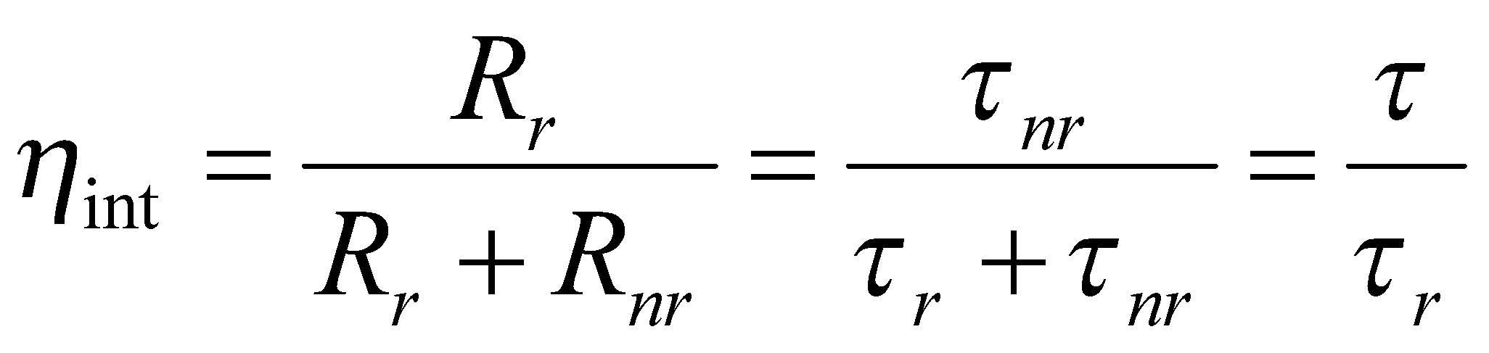
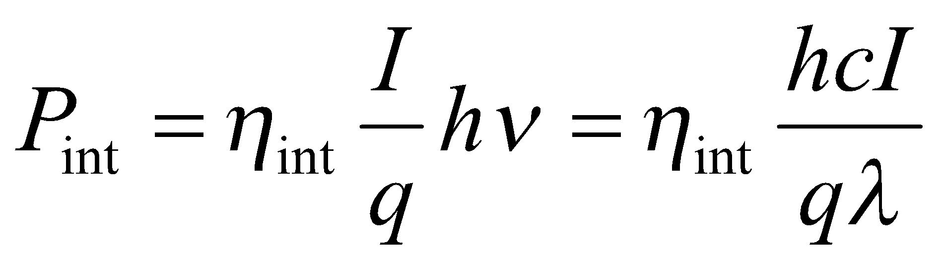

Internal Quantum Efficiency & Optical Power
[4-8]
Optical power generated internally in the active region in the LED is:
[4-9]

Slide 54
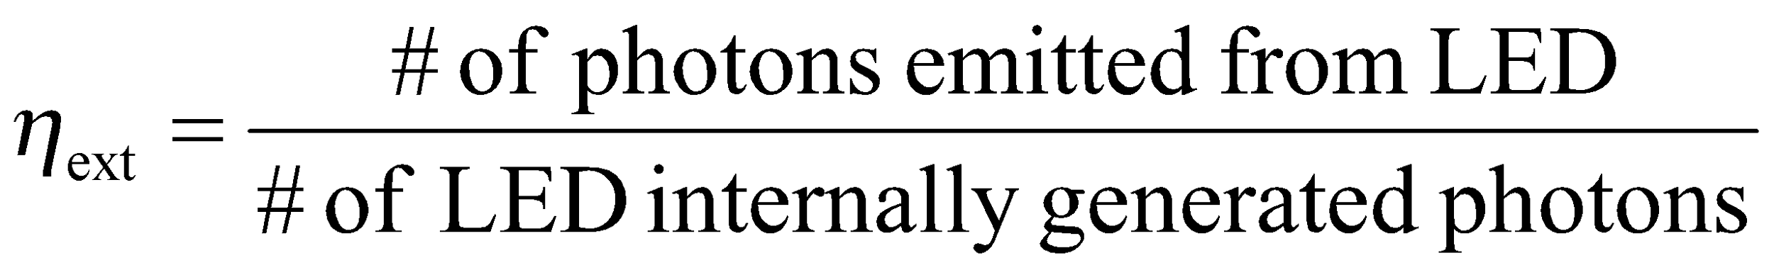
External Quantum Eficiency
In order to calculate the external quantum efficiency, we need to consider the reflection effects at the surface of the LED. If we consider the LED structure as a simple 2D slab waveguide, only light falling within a cone defined by critical angle will be emitted from an LED.
[4-10]

Slide 55
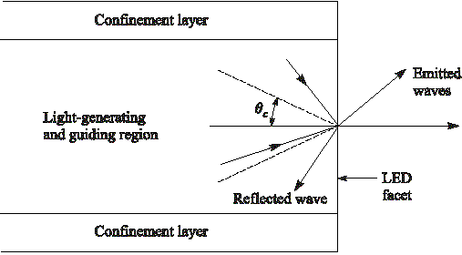
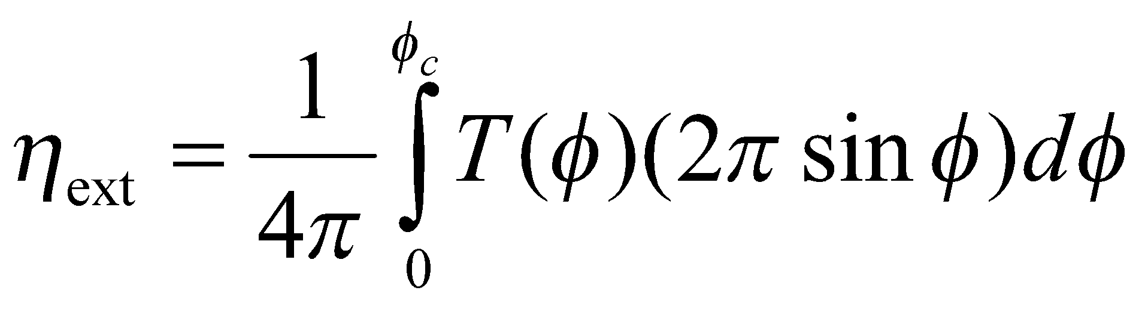
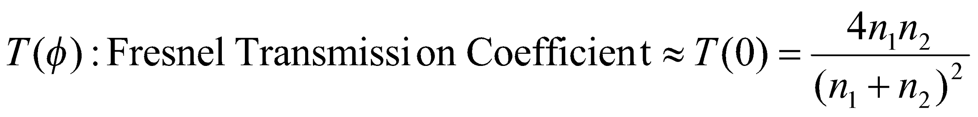
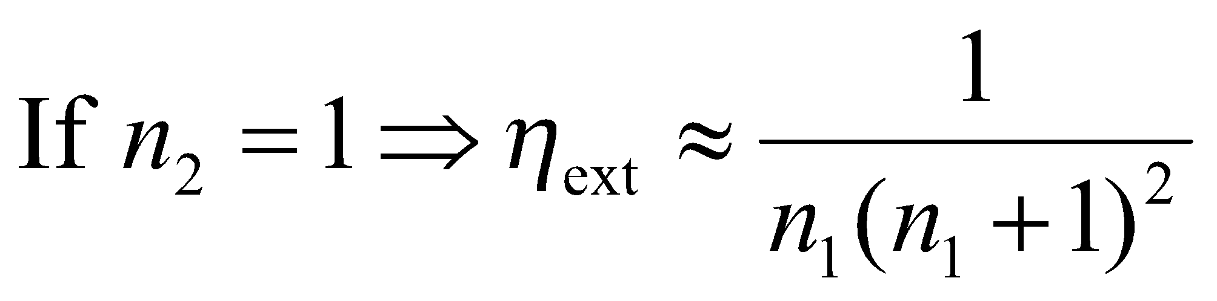
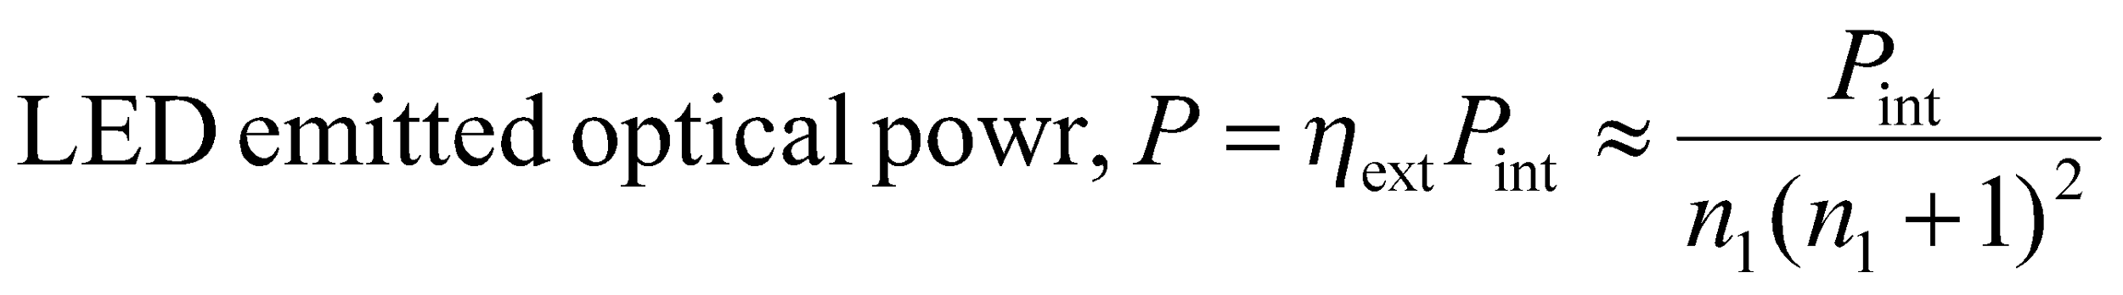
[4-11]
[4-12]
[4-13]
[4-14]

Slide 56


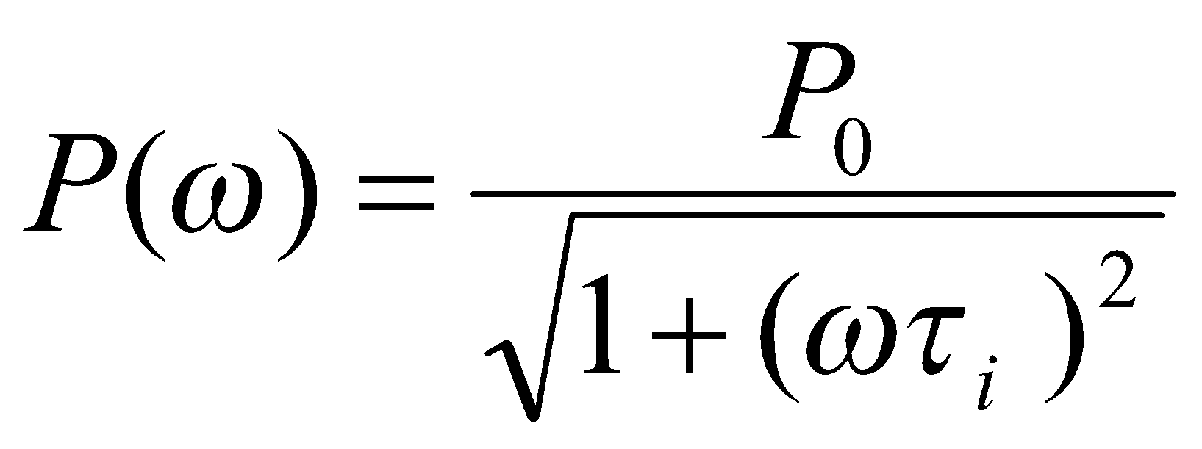
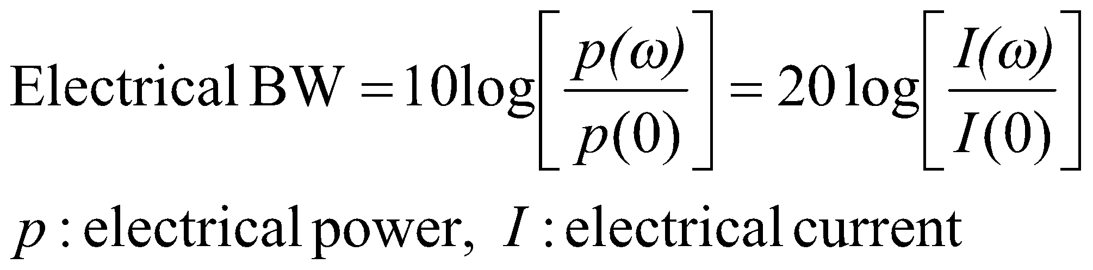
Modulation of LED
The frequency response of an LED depends on:
1- Doping level in the active region
2- Injected carrier lifetime in the recombination region, .
3- Parasitic capacitance of the LED
If the drive current of an LED is modulated at a frequency of the output optical power of the device will vary as:
Electrical current is directly proportional to the optical power, thus we can define electrical bandwidth and optical bandwidth, separately.
[4-15]
[4-16]

Slide 57
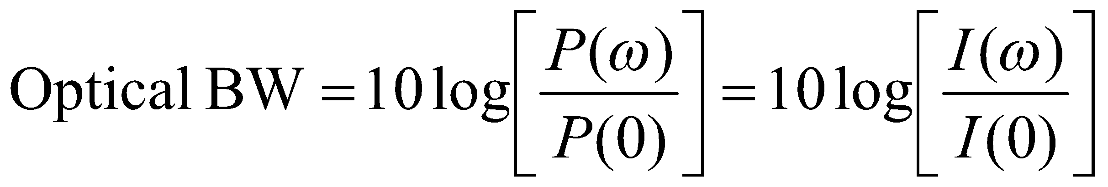
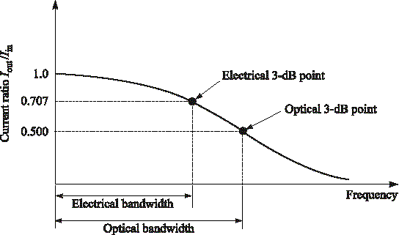
[4-17]
Optical Fiber communications, 3rd ed.,G.Keiser,McGrawHill, 2000

Slide 58
LASER DIODE MODES AND THRESHOLD CONDITIONS
UNIT 3-S6

Slide 59
LASER (Light Amplification by the Stimulated Emission of Radiation)
Laser is an optical oscillator. It comprises a resonant optical amplifier whose output is fed back into its input with matching phase. Any oscillator contains:
1- An amplifier with a gain-saturated mechanism
2- A feedback system
3- A frequency selection mechanism
4- An output coupling scheme
In laser the amplifier is the pumped active medium, such as biased semiconductor region, feedback can be obtained by placing active medium in an optical resonator, such as Fabry-Perot structure, two mirrors separated by a prescribed distance. Frequency selection is achieved by resonant amplifier and by the resonators, which admits certain modes. Output coupling is accomplished by making one of the resonator mirrors partially transmitting.

Slide 60
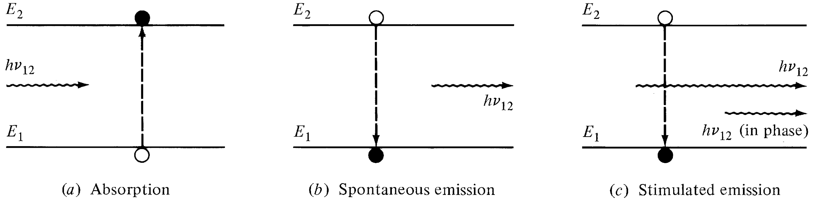
Pumped active medium
Three main process for laser action:
1- Photon absorption
2- Spontaneous emission
3- Stimulated emission
Optical Fiber communications, 3rd ed.,G.Keiser,McGrawHill, 2000

Slide 61
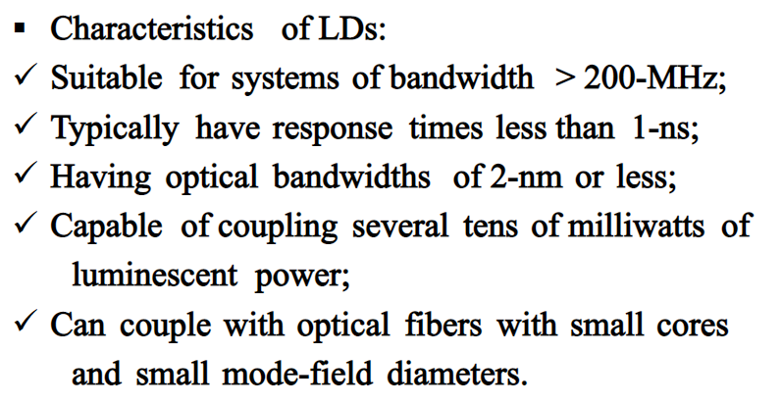
LASER DIODES

Slide 62
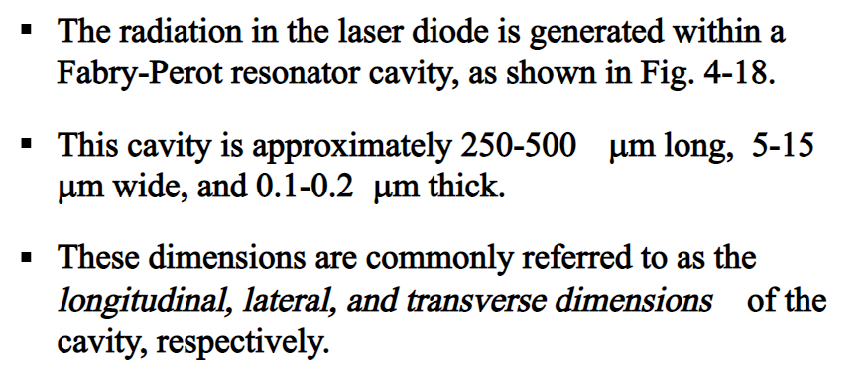
LASER DIODES

Slide 63


Slide 64


Slide 65




Slide 66


Slide 67


Slide 68


Slide 69



Slide 70


Slide 71


Slide 72



Slide 73


Slide 74


Slide 75


Slide 76



Slide 77
PHOTODETECTORS
S7-S9

Slide 78
PHOTODETECTORS
PHOTODETECTORS: Photodetectors find applications in the area of medical, automotive, safety and analytical equipments, cameras, communications, astronomy and industry.
Types of Photo detectors
Photodiode, Photodiode Array, Light Dependent Resistor
Avalanche Photodiode
Photomultiplier Tube, Micro channel Plate, Image Intensifier
Position Sensitive Detector
CCD

Slide 79
Photo detector Requirements for Performance
High sensitivity at the operating wavelength of the source
Short response time to obtain a desirable bandwidth
Minimum noise contribution
Compatible size for efficient coupling and packaging
Linear response over a wide range of light intensity
Stability of performance characteristics
Low bias voltage
Low cost

Slide 80
Photo detection Mechanisms
Photodetector converts light (power) into electrical signals (photocurrent).
There are two distinct photo detection mechanisms
1. External photoelectric effect :
Photomultiplier Tubes (PMT)
2. Internal photoelectric effect :
PN junction photodiodes
PIN photodiodes
Avalanche photodiodes

Slide 81
Photo detection Mechanisms
External photoelectric effect
Electrons become free from the metal surface by energy absorption obtained by streams of incident photons.
2. Internal photoelectric effect
Free charge carriers are generated by absorption of incident photons in semiconductor junction detectors.

Slide 82
Principle of Photodetection (In Semiconductor)
In semiconductors, conduction band and valence band are separated by a forbidden band gap.
Electrons at the valence band are bound. The electrons in the conduction band are free and when small voltage is applied they move and causes current flow
Populating the conduction band with electrons causes the semiconductor to conduct current.
The value of band gap Eg determines the conductive properties of semiconductor

Slide 83

PIN PHOTODIODE
The high electric field present in the depletion region causes photo-generated carriers to
Separate and be collected across the reverse –biased junction. This give rise to a current
Flow in an external circuit, known as photocurrent.

Slide 84

Energy-Band diagram for a pin photodiode

Slide 85






Photocurrent
Optical power absorbed, in the depletion region can be written in terms of incident optical power, :
Absorption coefficient strongly depends on wavelength. The upper wavelength cutoff for any semiconductor can be determined by its energy gap as follows:
Taking entrance face reflectivity into consideration, the absorbed power in the width of depletion region, w, becomes:
[6-1]
[6-2]

Slide 86



Responsivity
The primary photocurrent resulting from absorption is:
Quantum Efficiency:
Responsivity:
[6-3]
[6-4]
[6-5]

Slide 87


Responsivity vs. wavelength

Slide 88


Optical Absorption Coefficient

Slide 89


Slide 90


Slide 91


Slide 92


Slide 93


Slide 94


Slide 95

Avalanche Photodiode (APD)
APDs internally multiply the primary photocurrent before it enters to following circuitry.
In order to carrier multiplication take place, the photogenerated carriers must traverse along a high field region. In this region, photogenerated electrons and holes gain enough energy to ionize bound electrons in VB upon colliding with them. This multiplication is known as impact ionization. The newly created carriers in the presence of high electric field result in more ionization called avalanche effect.
Reach-Through APD structure (RAPD)
showing the electric fields in depletion region and multiplication region.

Slide 96


Slide 97


Slide 98


The responsivity of APD can be calculated by considering the current gain as:

Slide 99


Slide 100

Current gain (M) vs. Voltage for different optical wavelengths

Slide 101


Photodetector Noise & S/N
Detection of weak optical signal requires that the photodetector and its following amplification circuitry be optimized for a desired signal-to-noise ratio.
It is the noise current which determines the minimum optical power level that can be detected. This minimum detectable optical power defines the sensitivity of photodetector. That is the optical power that generates a photocurrent with the amplitude equal to that of the total noise current (S/N=1)
Equivalent circuit of photodetector

Slide 102



Signal Calculation
Consider the modulated optical power signal P(t) falls on the photodetector with the form of:
Where s(t) is message electrical signal and m is modulation index. Therefore the primary photocurrent is (for pin photodiode M=1):
The root mean square signal current is then:
[6-8]
[6-9]
[6-9]
[6-10]

Slide 103
Noise Sources in Photodetecors
The principal noises associated with photodetectors are :
1- Quantum (Shot) noise: arises from statistical nature of the production and collection of photo-generated electrons upon optical illumination. It has been shown that the statistics follow a Poisson process.
2- Dark current noise: is the current that continues to flow through the bias circuit in the absence of the light. This is the combination of bulk dark current, which is due to thermally generated e and h in the pn junction, and the surface dark current, due to surface defects, bias voltage and surface area.
In order to calculate the total noise presented in photodetector, we should sum up the root mean square of each noise current by assuming that those are uncorrelated.
Total photodetector noise current=quantum noise current +bulk dark current noise + surface current noise

Slide 104








Noise calculation (1)
Quantum noise current (lower limit on the sensitivity):
B: Bandwidth, F(M) is the noise figure and generally is
Bulk dark current noise:
is bulk dark current
Surface dark current noise: is the surface current.
[6-11]
[6-12]
Note that for pin photodiode
[6-13]

Slide 105




Noise calculation (2)
The total rms photodetector noise current is:
The thermal noise of amplifier connected to the photodetector is:
input resistance of amplifier, and is Boltzmann cte.
[6-14]
[6-15]

Slide 106



S/N Calculation
Having obtained the signal and total noise, the signal-to-noise-ratio can be written as:
Since the noise figure F(M) increases with M, there always exists an optimum value of M that maximizes the S/N. For sinusoidally modulated signal with m=1 and :
[6-16]
[6-17]

